Slide 1
P-TECH
(Pathways in Technology Early College High School) Norwalk
Teacher/SS Department Chair: Cecile St. Jean

Slide 2
Class Breakdown & Demographics
2 sections of the course were taught this year
39 Students all together (23 in one section and 16 in the other)
21 Females and 18 Males
21 students identify as Hispanic/Latino
12 students identify as Black/African American
2 students identify as multiracial
2 students identify as white
2 students identify as Asian/Asian Pacific Islander

Slide 3
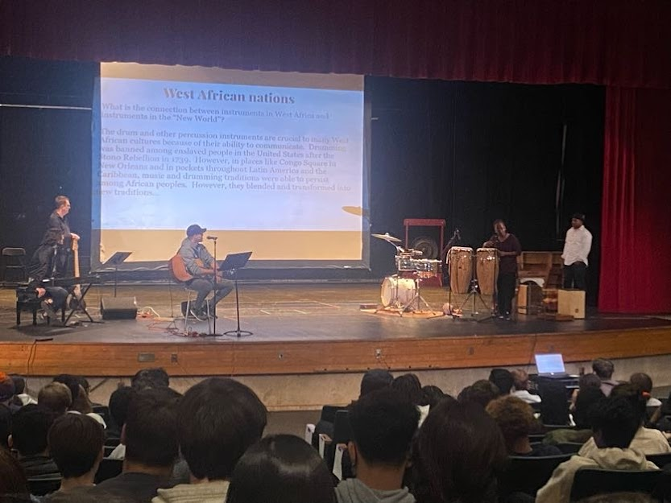
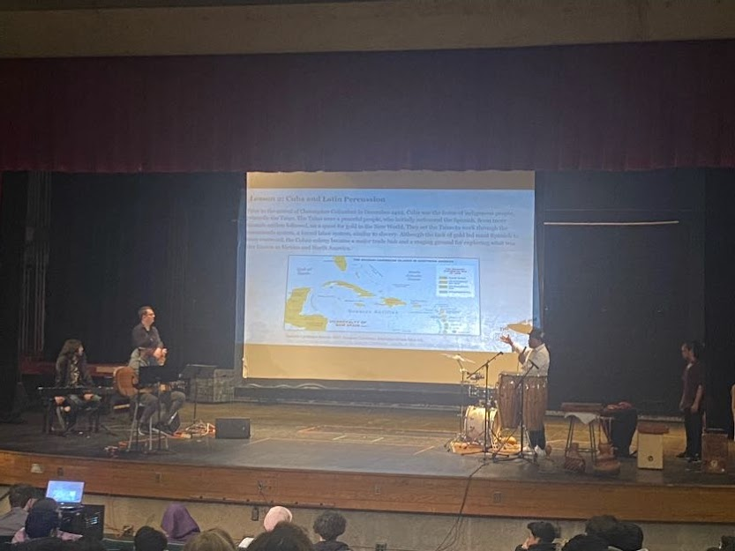

Slide 4
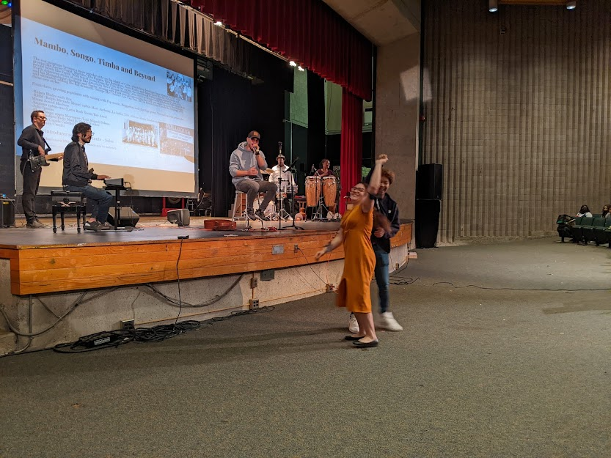
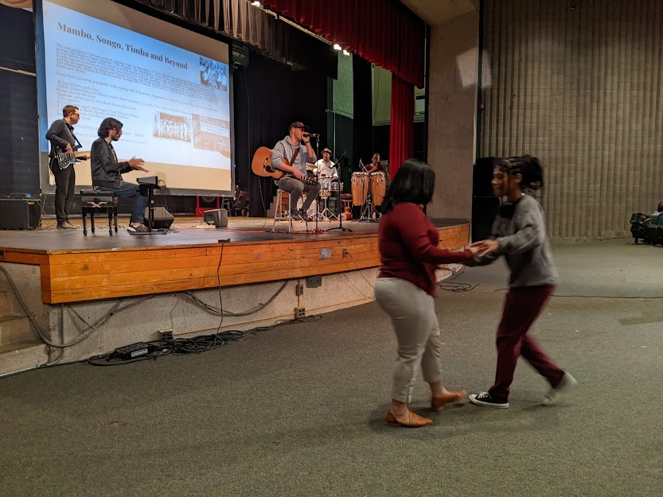

Slide 5
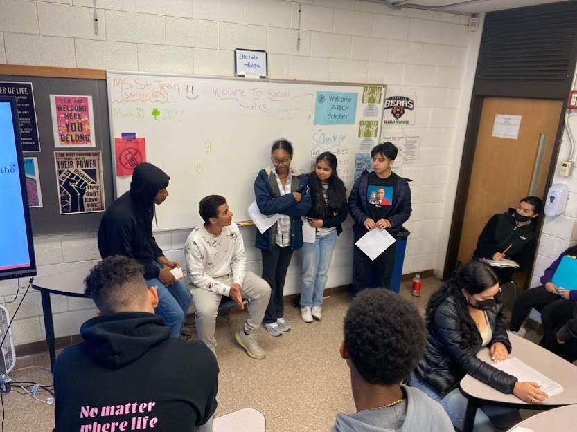
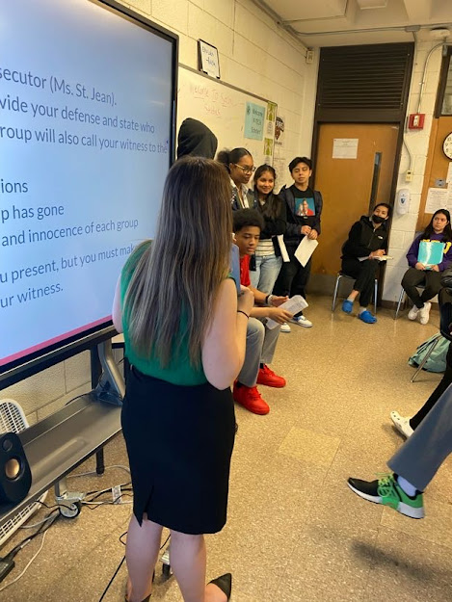

Slide 6
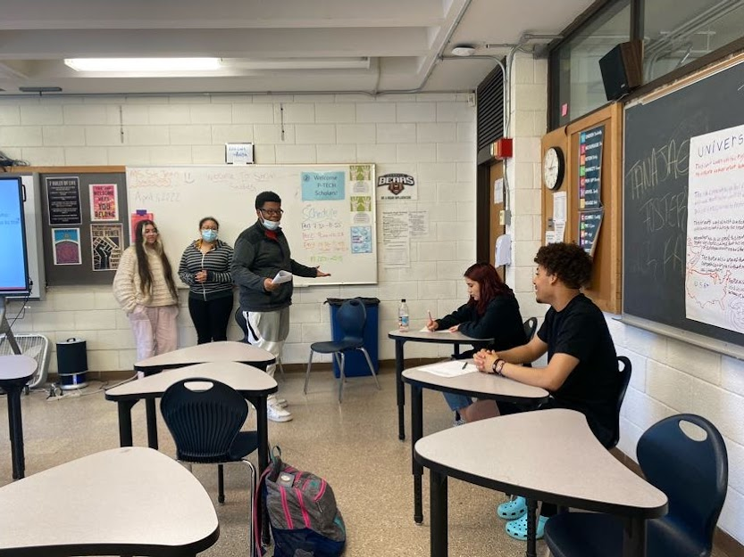
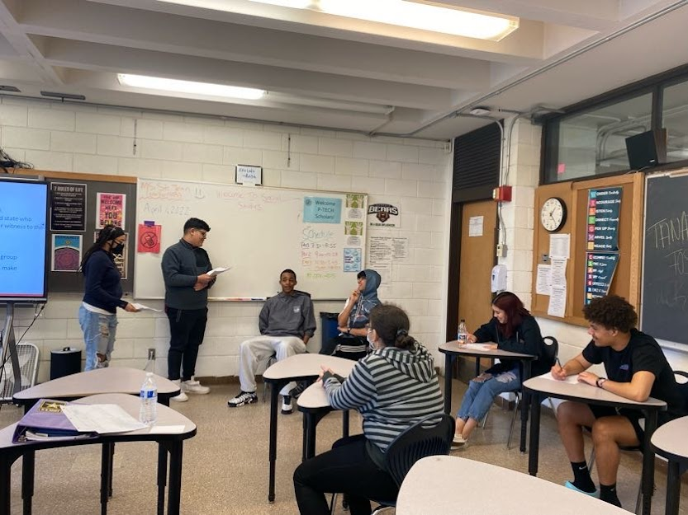

Slide 7
Student Presentations

Slide 8
Jaylah Reiph
Playlist Project
Directions: Your playlist should include at least 4-5 songs or TV shows/movies that you think represent the movement for racial equality and justice anytime between the 1960s and today - YOU choose the time period! With each selection you must have at least a 3 sentence description of how your selection is a representation of fighting to racial equality and justice.
https://docs.google.com/presentation/d/1iFnT05bQ5j9cvfM-dkw2uvQpFjwjsoqYZxIZ6TG-mfM/edit#slide=id.g11401c17815_0_18

Slide 9
Nicole Campos
Final Project
Directions: You will choose a topic from Latino History in the U.S. to conduct research about in order to create a magazine cover and article.
https://www.canva.com/design/DAFCc8lAUF0/i5FtL33p7fOQdZ918jKBAQ/view?utm_content=DAFCc8lAUF0&utm_campaign=designshare&utm_medium=link&utm_source=publishsharelink

Slide 10
Viviana Delgado
Mock Trial - Columbus V The People
Directions: Who/what was responsible for the slaughter of the Taino Indians? Everyone will be put on trial. You will be given a role that you will have to defend in court (Columbus, Columbus’ Men, The King and Queen, The Tainos, or the System of Empire). The teacher will be the prosecutor and a group of your peers will be the jury.
Vivian’s Role: Member of the Jury

Slide 11
Tanajae Foster
Playlist Project
Directions: Your playlist should include at least 4-5 songs or TV shows/movies that you think represent the movement for racial equality and justice anytime between the 1960s and today - YOU choose the time period! With each selection you must have at least a 3 sentence description of how your selection is a representation of fighting to racial equality and justice.
https://docs.google.com/document/d/1mLm4XXVYwaiLqofhmbfNJyhBaaAb9N2fu_u-bxM9zHw/edit

Slide 12
Soraya Gudiel
Final Project
Directions: You will choose a topic from Latino History in the U.S. to conduct research about in order to create a magazine cover and article.
https://drive.google.com/file/d/1sLvLgA9bjAQWOuZEoBu9gfpoMAal-TGr/view
https://drive.google.com/file/d/1NbX7GrMdeutwEgXTbDYO914OPYZboqu7/view

Slide 13
Vincent Velez
Final Project
Directions: You will choose a topic from Latino History in the U.S. to conduct research about in order to create a magazine cover and article.
https://drive.google.com/file/d/1YZwLr6m5ylKxZiNrFaQzuXm2AFwQnb9A/view
https://docs.google.com/document/d/1A6StQwSZCxqtJYkCtuht1wyzrTlNCDWAu6WX0QpNaM0/edit

